Slide 1
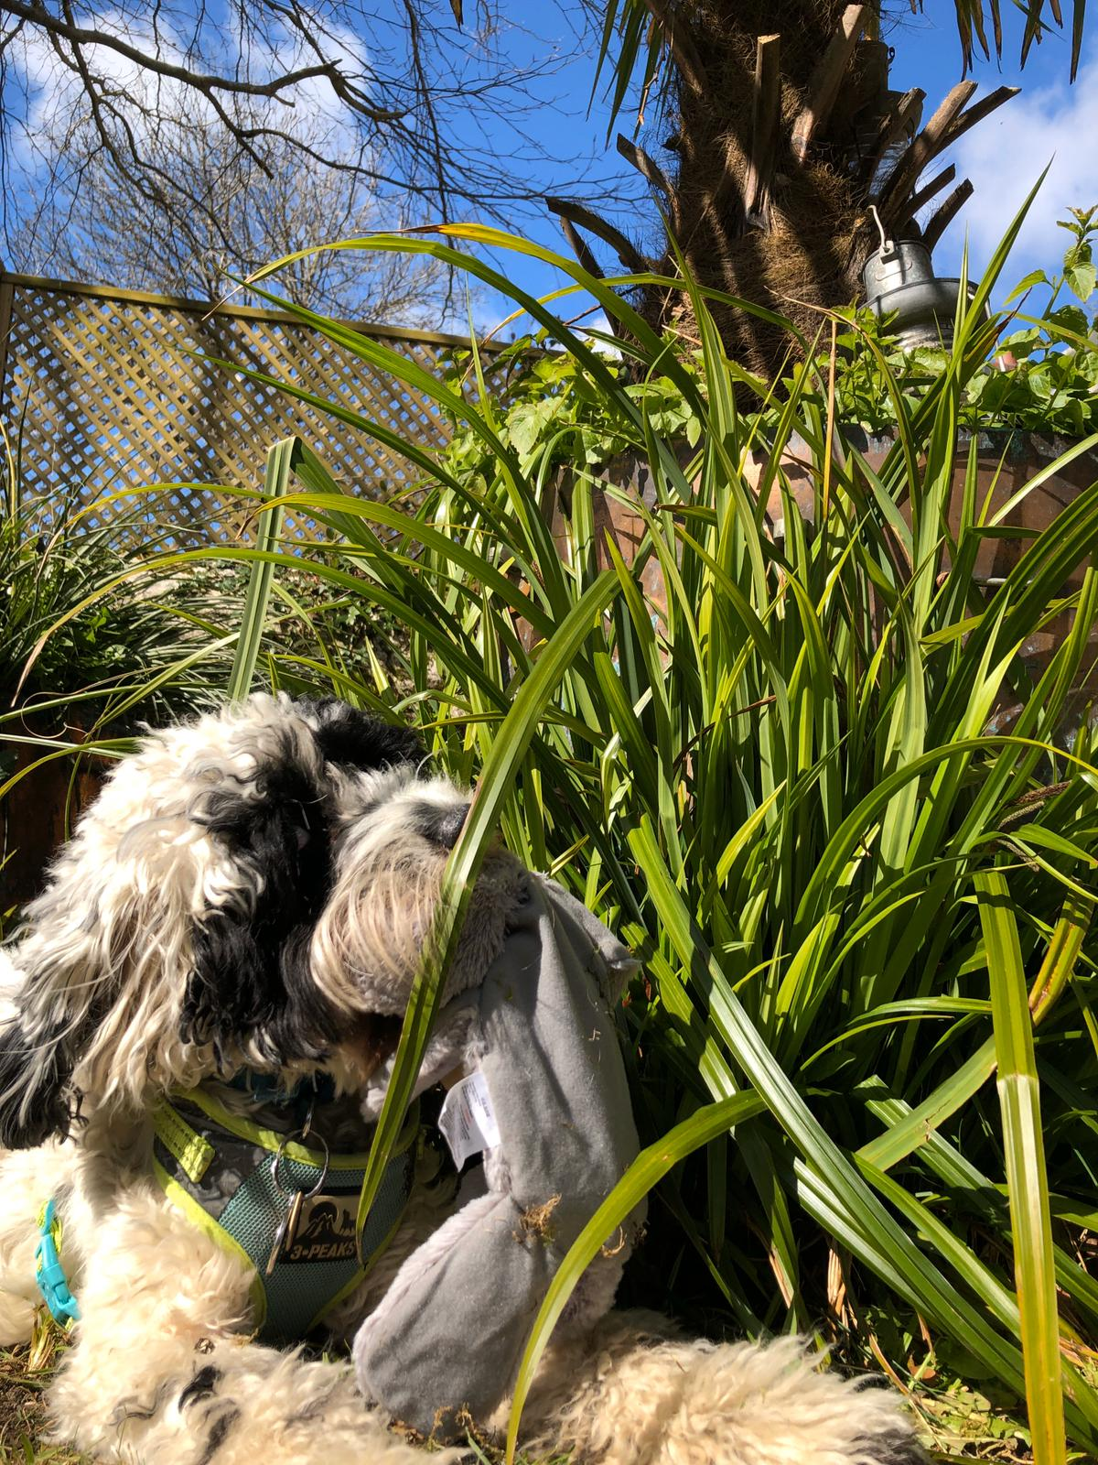
Bear’s
Sensory ladder
made by Bear and Kath S OT

Slide 2

my sensory ladder
fizzy whizzy
under alert
chilled, calm & learning
sleepy

Slide 3

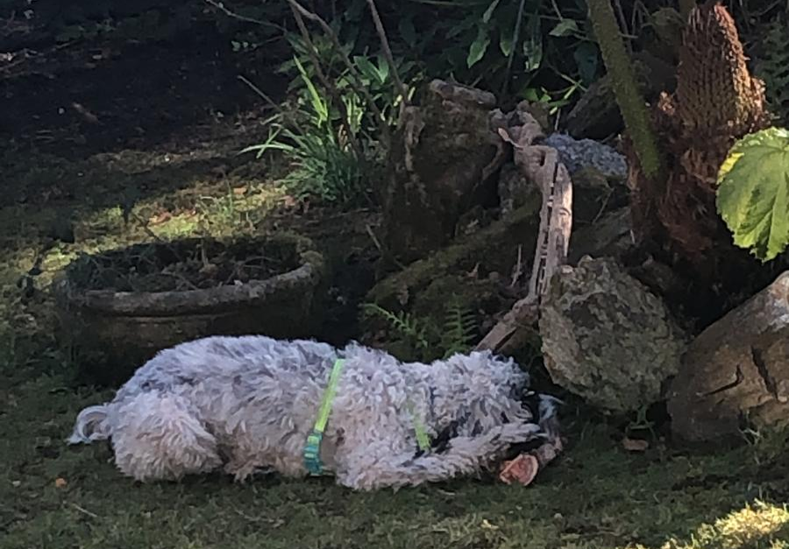
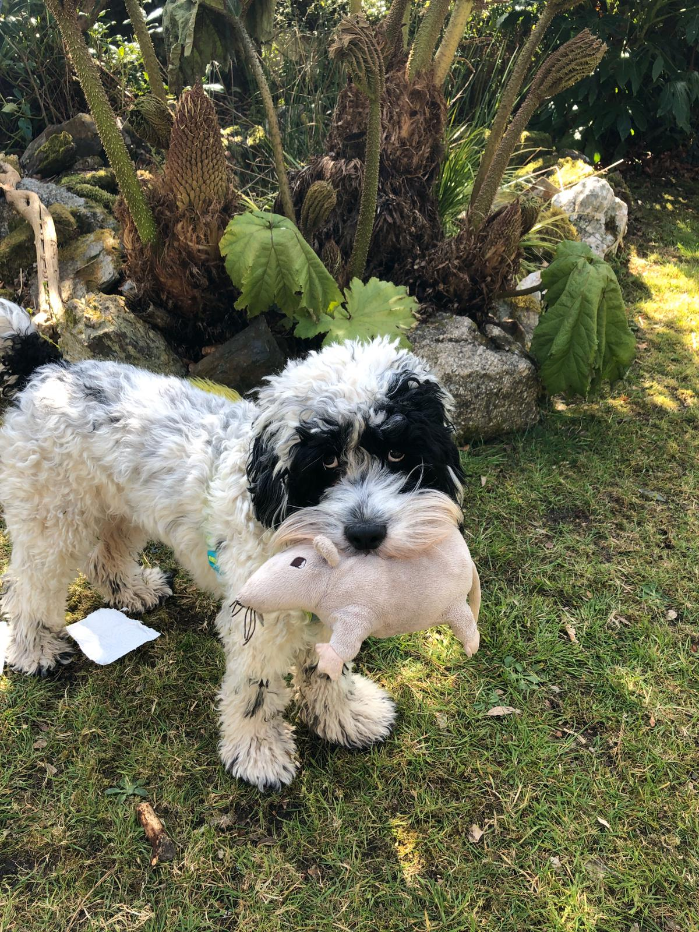
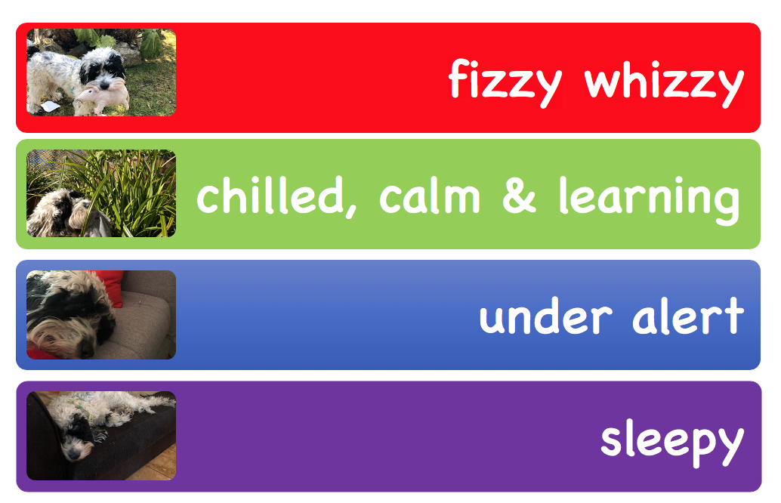
fizzy whizzy
eating a bone

Slide 4
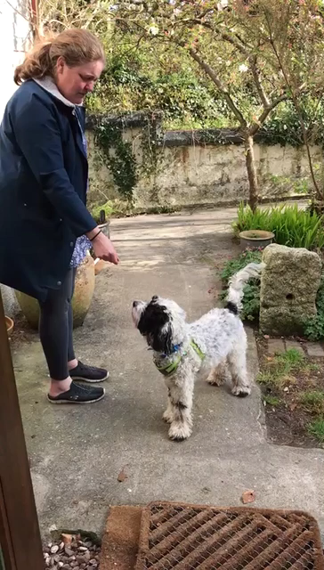
chilled, calm and learning

Slide 5
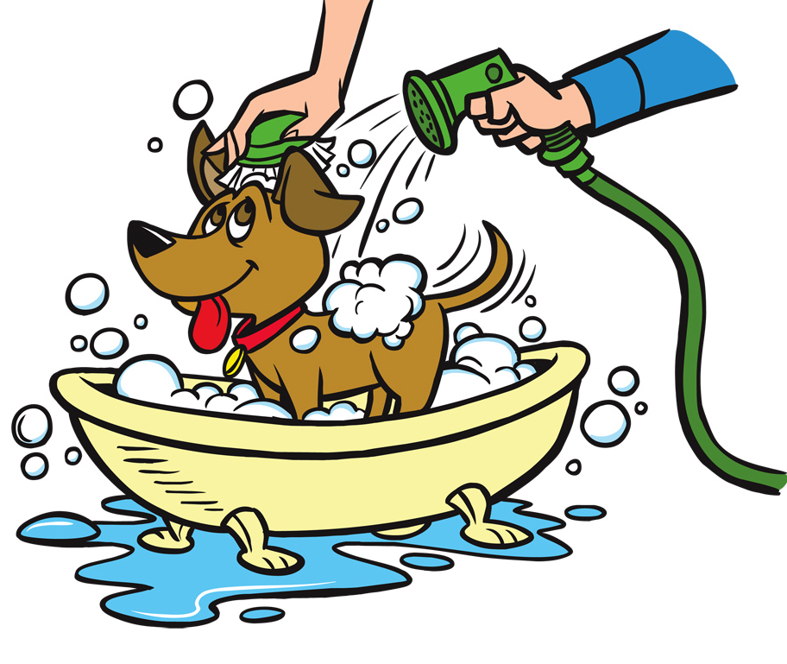
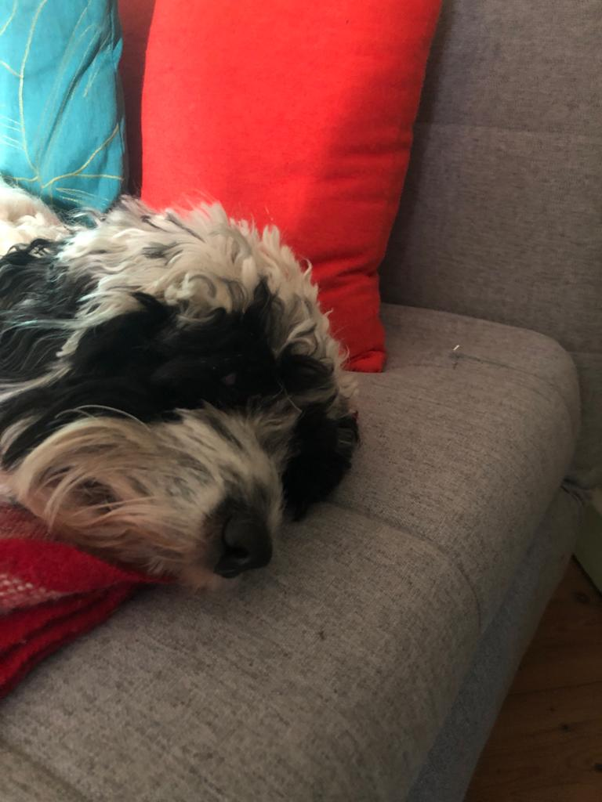
under alert
to wake more and be more alert

Slide 6
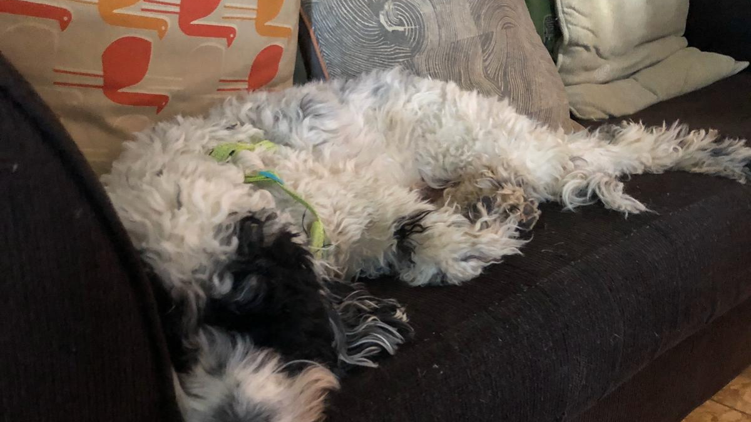
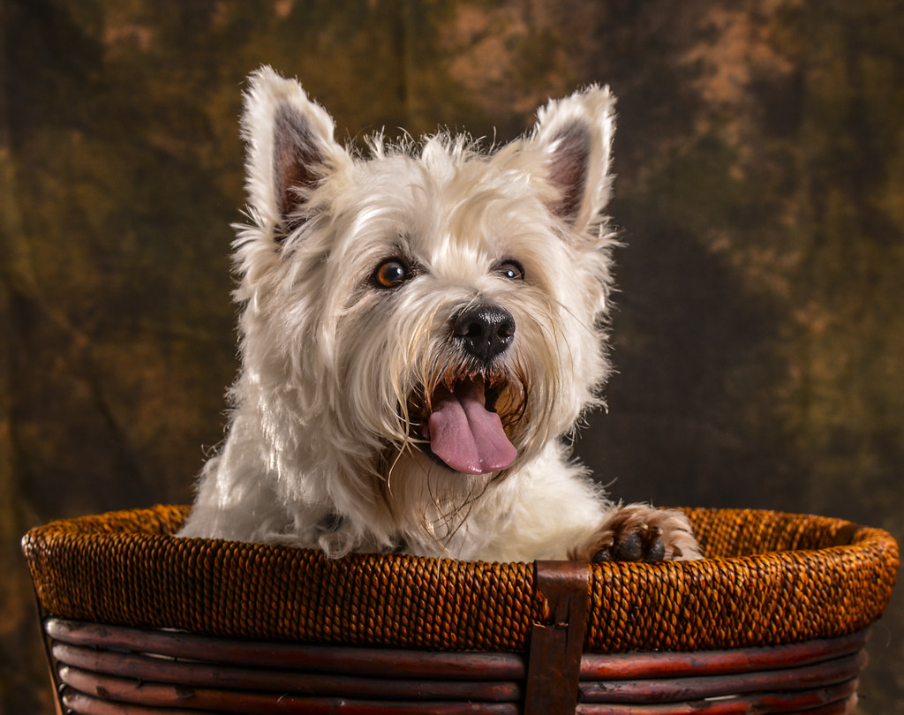
to get sleepy and stay asleep

Slide 7
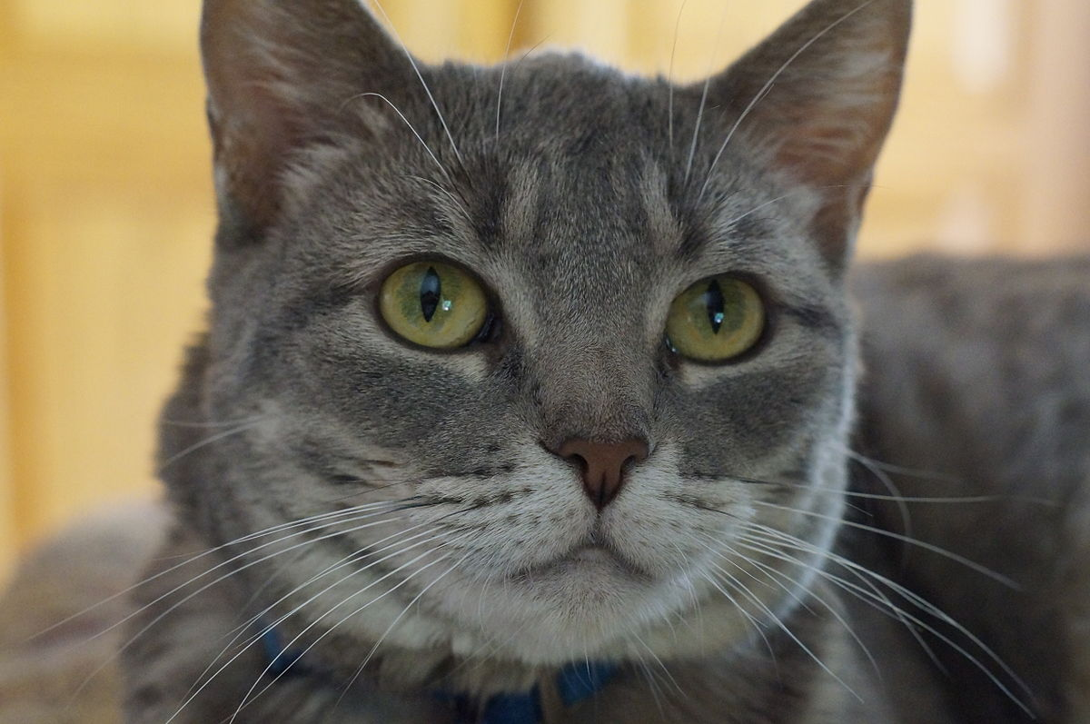
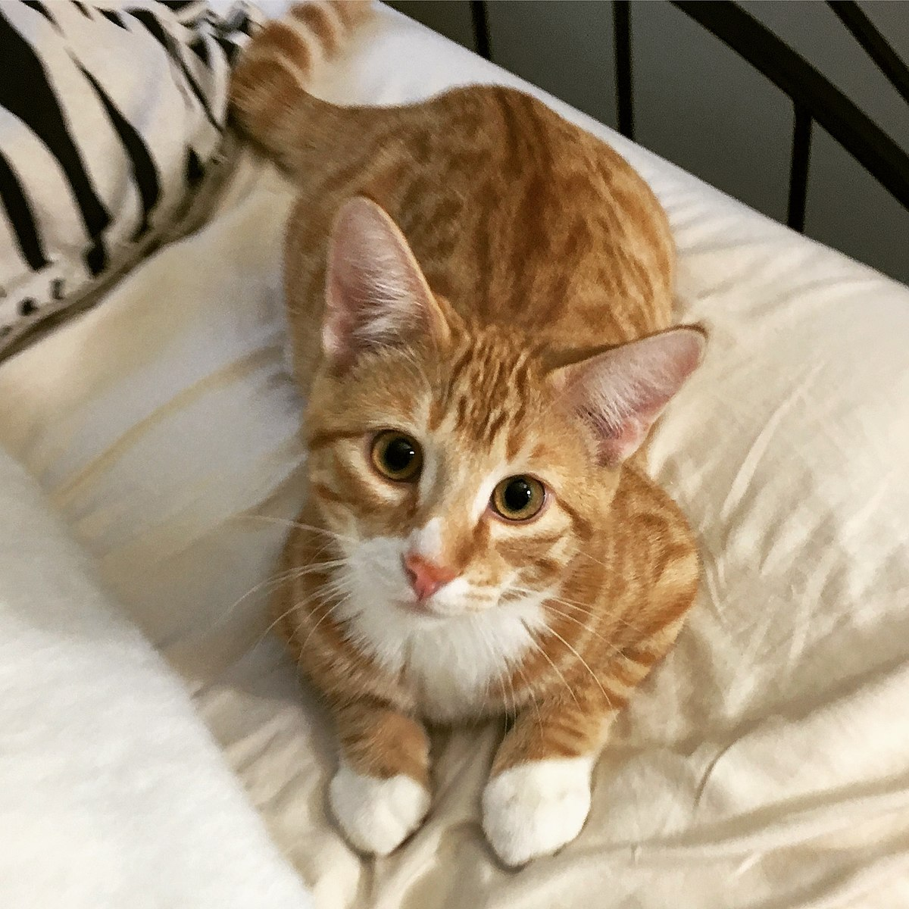
This Photo by Unknown Author is licensed under CC BY-SA
This Photo by Unknown Author is licensed under CC BY-SA

